Slide 1
Office of Financial Policy (OFP) Training Presentation
Using the OFP Site Search and VA Search
Notes:
OFP Site Search Tips PowerPoint Presentation

Slide 2
Overview
Review of the methods and search capabilities available for researching financial policy questions or concerns.

Slide 3
Agenda
Policy Research Considerations and Procedures
OFP Site Search
VA Search
FAQs
Policy Research Websites
Submission of Policy Questions and Contacts
Notes:
The specific tasks that you will be learning about are:
Policy research considerations and procedures, to include the two main ways to search financial policy:
by using the OFP Site Search in the Quick Links section on the OFP web pages, and
by using the VA search option available on all VA internet/intranet web sites in the upper right corner of the page, and
by using the Frequently Asked Questions (FAQs) website.
Policy Research Websites, VA and other;
Submission of Policy Questions; and
VA Administration and Other Staff Office Contacts

Slide 4
Policy Research Considerations
Determine the basis for the question: Is it related to finance and accounting policy or is it a system or other procedural question?
Need assistance entering a transaction in IFCAP, CAATS, etc.
Need assistance on determining whether funds may be retained.
Notes:
Prior to beginning your research, you should first determine what the basis is for the question. For example, is it related to finance and accounting policy, related to another function, or is it related to procedures or specific steps needed to accomplish a certain task.
If you need assistance in entering a transaction in IFCAP, FMS, CAATS, or another system, this is a procedural question, not really policy. To prevent a delay in assistance, you should try to get help from the appropriate point of contact rather than sending a question to policy. Contact administration, regional, and/or facility technical and subject matter experts for particular procedures. In most cases, the policy office would send your question to another office on your behalf.
However, if it is a financial policy question such as trying to determine if funds received may be retained by VA or deposited to Treasury miscellaneous receipts, you should take the steps outlined in the following slides prior to sending a request for assistance.

Slide 5
Policy Research Procedures
Review OFP, Administration, regional, and/or facility (station) policy and procedural materials,
Use references and resources included in the Policy for additional research, to include Comptroller General (CG) decisions, Code of Federal Regulations (C.F.R.), and U.S. Code references, and
Perform “site searches.”
Notes:
Review known existing OFP, Administration, regional, and/or facility (station) policy and procedural materials, and
Use references and resources included in the Policy for additional research
Perform “site searches”.
The OFP financial policies provide overall VA financial policy. To aid in your research, the OFP policy chapters contain an Authorities and References section and include references throughout the chapter. Be sure to check these as they may provide the additional information you are trying to locate in answer to your question. Instead of the chapter, you may find the answer in a Government Accountability Office (GAO) legal decision or the Appropriations Law Redbook, in the Code of Federal Regulations (CFR), U.S. Codification of public laws, or another reference listed.
If you are new to researching financial policy, you will find additional hyperlinks at the end of the presentation by Administration, other VA staff office, and other Federal government web sites. For field level specific financial policy, you should also check these in conjunction with the overall VA policy. These sites are also available on the OFP internet web site under the Quick Links section as Related Web Sites and Additional Resources and Information and on the OFP intranet web site in the left column as the same titles.

Slide 6
OFP Policy Research Example – OFP Site Search
Notes:
On the OFP web site, there are two types of site searches:
The OFP Site Search located on the right side of the page (under Quick Links) is specifically set to search only within the OFP web site (within OFP web site or just within OFP policies?). This is a good place to begin when you are most interested in the overall VA financial policy and references.
The VA Search is located in the upper right corner and is a good tool when you need to reduce the number of documents found, you want to include or perhaps exclude certain criteria, or you need to search beyond the OFP policy. This site search can also be used in the same manner as the OFP Site Search, that is, to search only within the OFP web site. The additional filters in the VA Search allow a user to further refine results.
Let’s say, you have been asked a policy question about the possibility of purchasing a kitchen appliance with general operating funds (appropriated funds) for a break room that is accessible and used by all employees.
You know that in general, appropriated funds may not be used, but you have seen them in other facilities and have been told they were properly purchased with appropriated funds. You have checked your known resources and would like to know if there is VA policy on the subject.
In the next slides, we review how the OFP Site Search in the Quick Links column can be used.

Slide 7
OFP Policy Research Example – OFP Site Search
Notes:
After the OFP Site Search has been selected, there are a couple of ways to search. You can simply type in what you are researching or you can be more specific. In the Search For box, type in kitchen appliances. The search engine will search on the combination of the words and also the individual words.

Slide 8
OFP Policy Research Example – OFP Site Search
Notes:
In the example of kitchen appliances, 9 documents are located on the OFP web site. The second result listed is a specific policy, Volume V Chapter 10B, Kitchen Appliances. Read the chapter for the policies and procedures and refer to the Comptroller General decisions and Authorities and References listed. If you are still not sure and you have researched the policy references, you would then refer your question to your next level of financial support.
Although this search didn’t find an abundance of documents, some simple searches can result in more documents than a person has time to review. In those instances, you will want to limit the number of results from your search query.

Slide 9
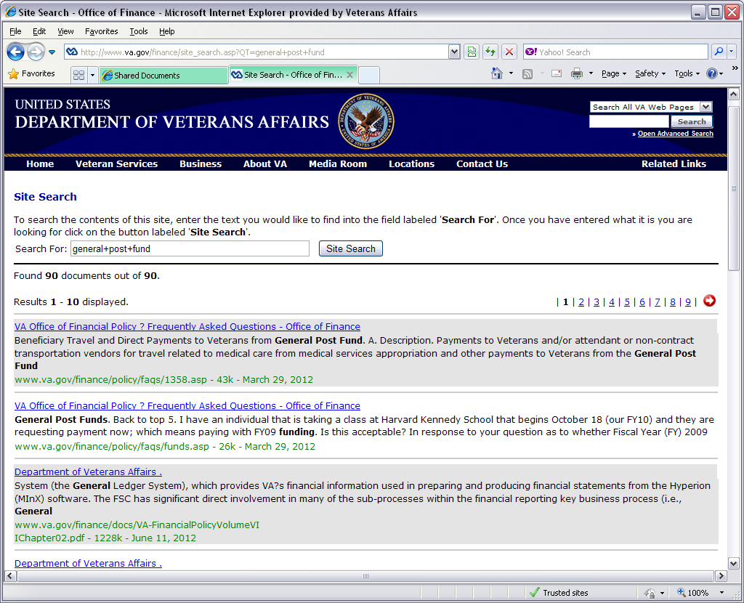
OFP Policy Research Example – OFP Site Search
Notes:
Let s look at another search. In this example, search on the words general post fund. The initial search displays 90 documents. Rather than having to weed through all of these, it is possible to vary the search just slightly to reduce the number.

Slide 10
OFP Policy Research Example – OFP Site Search
Notes:
This time, we’ll use “general post fund” (with quotes). When this slight change is made, the number of documents is reduced to 18. A more manageable number to research. Also notice the difference in how the search words are displayed.
Something to keep in mind when using this type of search is that the quotes restrict the search to how the words are typed.

Slide 11
OFP Policy Research Example – OFP Site Search
Notes:
For instance, let’s use “general post funds” (with an “s” and quotes). The search only results in 4 documents as compared to 18 on the previous slide. Depending upon the results you receive, you may need to adjust your query slightly to ensure that your search is effective.
In the following slides, we will review another search method, the VA Search located at the top right of the web page, and how this can be used to further refine your results. The VA Search is more robust search engine with varying capabilities.

Slide 12
OFP Policy Research Example – VA Search
Notes:
The VA Search option is located in the upper right of all VA web pages. The default is set to “Search All VA Web Pages.” Select “Search Current Site Only.”

Slide 13
OFP Policy Research Example – VA Search
Notes:
After “Search Current Site Only” is selected, type in general post fund.

Slide 14
OFP Policy Research Example – VA Search
Notes:
The general post fund search displays 90 documents, same as the other search. Keep in mind, this number may vary from one time period to another based upon chapters being added or rescinded and other documents being added or removed from the OFP web site.
However, rather than using the quotes, we will review how selecting the Use Advanced Search hyperlink displayed above the Search button can be used to adjust the search.

Slide 15
OFP Policy Research Example – VA Search
Notes:
The Advanced Find screen is displayed. Notice that above the selection boxes, the screen tells you that it is searching on the Finance web site and it lists the URL in the Search within a site or domain box. If you do not see this or see something else, you may not have selected the Search Current Site Only option. As a reminder you, you should try to started from an OFP web site for this search if it is the only site you want to search. If you didn’t, you can also type in the site or domain URL. The advanced find is very beneficial if you are wanting to include or exclude additional criteria in your search.
The advanced find also allows you to select what type of documents you wish to search on. For instance, if you wanted to expand your search to Health Programs or Medical Centers, you would deselect the ones you don’t want to consider and remove the site address listed in the site or domain box. For our purposes, we are only interested in the OFP documents, because this is where the OFP VA Policy resides. After ensuring that general post fund is entered in All of these terms box, the Advanced Search button would be selected.

Slide 16
OFP Policy Research Example – VA Search
Notes:
In this search, we again receive 90 documents because we really didn’t change anything. In the next slide, we will simply move general post fund into the Exact wording or phrase: search box, and you will see how this reduces number of documents.

Slide 17
OFP Policy Research Example – VA Search
Notes:
This example displays general post fund in the Exact wording or phase: search box. The Advanced Search would be selected. You don’t need to use quotes for this search.

Slide 18
OFP Policy Research Example – VA Search
Notes:
The displayed results are now down to 18 documents and is more manageable than 90 documents.
You can further refine these results as needed with the Advanced Search options. The Help selection provides tips and guidance on how to use the options listed in the Advanced Search.
Let’s take a quick look at how selecting another type of document affects the results.

Slide 19
OFP Policy Research Example – VA Search
Notes:
Besides National Programs, we have selected Health Programs, Medical Centers, and Health Research topics. The OFP website in the Search within a site or domain has been removed and the Advanced Search is selected. Anytime you wish to search outside of the OFP website, you would need to ensure that the site or domain box are blank. You can also set this to another site or domain as needed.
The advanced find will search throughout the VA website and display the results found by the areas. You can scroll down or click on the number to the left of the area to go to those results.
The search capabilities available on the VA Search web site are more robust and very beneficial when you are not sure quite sure of what you might need or what is available.
As noted in the previous slide, the Help selection provides tips and guidance on how to use the options listed in the Advanced Search.

Slide 20
OFP Policy Research Example – FAQs
Notes:
Another useful area available in the OFP Web Site is the addition of the Frequently Asked Questions (FAQs) web page. Although this page is still under construction, it does include some of the most frequently asked questions received in the OFP Accounting Policy mailbox.

Slide 21
OFP Policy Research Example – FAQs
Notes:
The FAQs are grouped by the volume topics. These will be updated on a regular basis to ensure that the most current issues are addressed. The responses provide the appropriate policy guidance that the answer was based on.
FAQs are also displayed in search listings along with chapters and other documents. Be sure to check these to see if someone else has previously submitted a similar question.

Slide 22
VA Policy Research Web Sites
VA OFP Website: http://www.va.gov/finance/policy/index.asp and http://vaww.va.gov/FINANCE/policy/index.asp (VA only)
VA OFP Publications: http://www.va.gov/finance/policy/pubs/
VA Publications: http://www.va.gov/vapubs/
VHA Policy Website: http://www.va.gov/vhapublications/
VBA: http://www.benefits.va.gov/WARMS/Site_Map.asp
VA General Counsel Publications: (VA only) http://vaww.ogc.vaco.portal.va.gov/library/default.aspx.
VA OIG: http://www.va.gov/oig/publications/
HR Policy: http://vaww1.va.gov/ohrm/HRLibrary/Dir-Policy.htm
Notes:
When you are researching financial policy, there are several web sites besides the local resources you may know. In addition to the OFP chapters, that are available, each Administration and Staff Office or organizations may have a central site.
The web sites listed are the most popular ones for the Administrations, Office of General Counsel, Office of the Inspector General, and Human Resources. Although VA Medical Centers, Regional Offices, Cemeteries, etc. may have their own repository of copies, these web sites should be used for the most recent policy.
In addition to these, there are other Federal authorities that may need to be researched for policy and guidance.

Slide 23
Other Policy Research Web Sites
Federal Accounting Standards Advisory Board (FASAB):
http://www.fasab.gov/
Government Accountability Office (GAO) Principles of Federal Appropriations Law (Redbook):
http://www.gao.gov/legal/redbook.html
GAO Legal Decisions, including Comptroller General Decisions:
http://www.gao.gov/legal/index.html
Government Printing Office Official Government Publications, e.g., Public Laws, U.S.C., C.F.R.:
http://www.gpo.gov/fdsys/search/home.action
Notes:
Displayed is a listing of several other Federal web sites they may be searched for an answer or guidance. An example of when another Federal web site may need to be used are for questions that deal with appropriations law. While the OFP chapters provide overall financial policy and some procedures, many questions dealing with appropriations law are not specifically address in the policy chapters. There are only a handful of chapters that discuss appropriations law. For example, Vol II Ch 4, Awards, Ceremonies, Food or Refreshments, Gifts or Mementos, and Vol V Ch 10B, Use of VA Appropriated Funds to Purchase Kitchen Appliances, specifically address many of the appropriation related questions and concerns surrounding these events or items. References to specific Comptroller General decisions are also noted.
However, it is not possible to write overall VA policy for every circumstance or situation, especially those dealing with the propriety of using an appropriation for a specific or unusual obligation. VA policy is meant to provide guidance for users to be able to make those determinations. For appropriations law, two of the best resources are the GAO websites and also the VA OGC publications that are listed on the previous slide.
To properly research an appropriations law question, you may need to refer to the Principles of Federal Appropriations Law, also known as, the Redbook, or the Comptroller General Decisions that have been issued. Many of the decisions are referenced in the Redbook and are also searchable on the website.
The FASAB web site is the Federal governments generally accepted accounting principles or GAAP. The FASAB Concepts, Standards Advisories, and other publications are the finance and accounting standards that VA uses.
The GPO Official Government Publications web site is a repository for accessing and researching public laws, U.S. Code (Codification of laws), and the Code of Federal Regulation (C.F.R. – Federal Agency legislation.)

Slide 24
Submission of Policy Questions
Determine the subject of the inquiry.
Financial/Accounting Policy
Technical Procedures, e.g., FMS, IFCAP, CAATS, FAP
Other Office Policy, e.g., Procurement, Acquisitions, Construction
Formulate the specific question with appropriate details and extenuating circumstances, and research or findings. Try to be specific, but concise.
Initially contact administration, regional, and/or local offices for assistance. Contact administration, regional, and/or facility technical and subject matter experts for particular procedure.
Notes:
Even after using all of the research tools and websites available, you still have questions, these should be submitted through the appropriate chain of command for an official response. Make sure that your question and supporting documentation accurately reflects the issue.
Also be sure to submit questions through your appropriate chain of command. This will help to ensure that the response you receive is appropriate to your area and prevent delays. For example, if OFP APPS receives a financial policy question form a medical center, the question will generally be forwarded to the VHA Accounting Policy group.
On the following slide is a listing of Administration contacts.

Slide 25
VA Administration and Other Staff Office Contacts
OFP Outlook contact: OFP Accounting Policy
VHA Outlook contact: VHA Accounting Policy (103A)
VBA Outlook contact: VAVBAWAS/CO/FINREP
NCA Finance Service: Ph# 540-658-7280 (Finance Group)
Other Contacts: http://www.va.gov/finance/policy/contacts.asp
Notes:
The contacts listed above should be used for policy questions. As noted in the prior slides, Research Considerations and Procedures, these contacts should be used to prevents delays in policy responses.
Other contacts, as appropriate, are also listed on the OFP website and within each financial policy chapter.

Slide 26
Summary
In summary, we’ve discussed the following:
Site search options and considerations
Additional common search webs sites
For additional information available on the OFP web site, refer to the internet web site, http://www.va.gov/finance/policy/index.asp, or the VA intranet web site (VA only), http://vaww.va.gov/finance/policy/.

Slide 27
Some Parting Thoughts for Financial Policy
We can only perform functions/missions and spend funds in accordance with legislature or other regulatory guidance.
If you have completed the research and you still have questions concerning the legality or appropriateness of purchasing or providing a product or service, it probably isn’t authorized.
Use your chain of command to address your questions.

