Slide 1
HUD’s Housing Counseling Program: The Importance of Research and Metrics
Sarah S. Gerecke, Marina L. Myhre
October 4, 2018

Slide 2
Agenda
Housing Counseling Research
Office of Housing Counseling Data Collection
How Research and Data Inform Program Decisions

Slide 3
HUD Office of Housing Counseling
“The mission of the Office of Housing Counseling is to help families to obtain, sustain and retain their homes. We will accomplish this mission through a strong network of HUD-approved housing counseling agencies and counselors.”
HUD reaches more than 1 million families through a network of approximately 1,800 housing counseling agencies
HUD monitors compliance, conflicts of interest, and the quality of housing counseling provided by these agencies
HUD provides grant funding for qualified agencies

Slide 4
Marina L. Myhre, Ph.D. Social Science Analyst, Program Evaluation Division Office of Policy Development and Research, U. S. Department of Housing and Urban Development

Slide 5
What is the history of HUD housing counseling studies?
I. HUD Pre-Purchase Housing Counseling Demonstration (1979)
II. Recent series of HUD studies on housing counseling:
The State of the Housing Counseling Industry (2008)
Housing Counseling Outcome Evaluation: Foreclosure and Pre-Purchase Counseling Outcome Reports (2012)
III. The First-Time Homebuyer Education and Counseling Demonstration
The First-Time Homebuyer Education and Counseling Demonstration: Early Insights Report (2016)
The First-Time Homebuyer Education and Counseling Demonstration: Baseline Report (2017)

Slide 6
What are other housing counseling studies and experiments finding?
HUD has reviewed around 50 studies of the program
Most show positive correlation between housing counseling and better credit, reduced debt, greater savings, higher satisfaction with the mortgage process and fewer foreclosures
A number of those studies have been experiments and have found positive effects on delinquencies on debt and lower odds of foreclosure, and reduction in mortgage default rates for FTHB with subprime credit or low-income FTHB

Slide 7
What are the goals of the HUD FTHB Homebuyer Education and Counseling Demonstration?
Objective:
To measure the impact of offering homebuyer education and counseling to a sample of approximately 5,800 low-, moderate-, and middle-income prospective first-time homebuyers in 28 cities across the country.
Research Questions:
To what extent does homebuyer education and counseling affect outcomes related to:
Preparedness and Search
Financial Capability and Management
Sustainable Homeownership

Slide 8
What is the HUD FTHB Homebuyer Education and Counseling Demonstration design?
Target Population
Low-, moderate- and middle-income (less than 120% of AMI)
Prospective first-time homebuyer
Lender referred customers who had applied for pre-qualification/pre-approval/loan
Anyone participating in a downpayment assistance or other program that required homebuyer education or counseling was excluded
Study Sample
5,854 LMMI, FTHB participants in 28 U.S. metropolitan areas
Study Design
Randomized-Controlled Trial (RCT)
3 treatment groups (remote, in-person, and “choice”), 1 control group
3 Surveys: Baseline, 12-/18-month, and 36/60-month follow-up surveys
3 Types of Administrative Data: Biannual credit report and loan-origination and servicing data, service tracking data

Slide 9
What are the key takeaways of the Demonstration?
HUD successfully implemented a large-scale randomized experiment
This study is groundbreaking in its scale, experimental design, elimination of any selection bias, and expected length that the families will be followed
Early findings show improved mortgage literacy, greater appreciation for communication with lenders, and improved underwriting qualifications

Slide 10
Sarah Gerecke Deputy Assistant Secretary, Office of Housing Counseling U.S. Department of Housing and Urban Development

Slide 11
Housing Counseling Service Activity (FY17)
Total Counseling Activity – 1,121,957 Clients

Slide 12
The Impact of Housing Counseling Services (FY17)
345,612
Worked with housing counselor to develop a sustainable household budget
309,706
Received fair housing information
165,605
Gained access to resources to help improve housing situation
Improved financial capacity
171,142

Slide 13
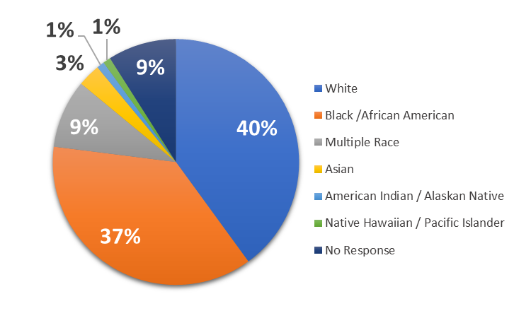
Service Usage: Racial Demographics (FY 17)

Slide 14
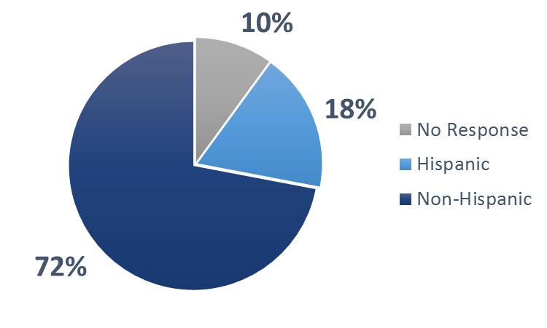
Service Usage: Ethnicity Demographics (FY 17)

Slide 15
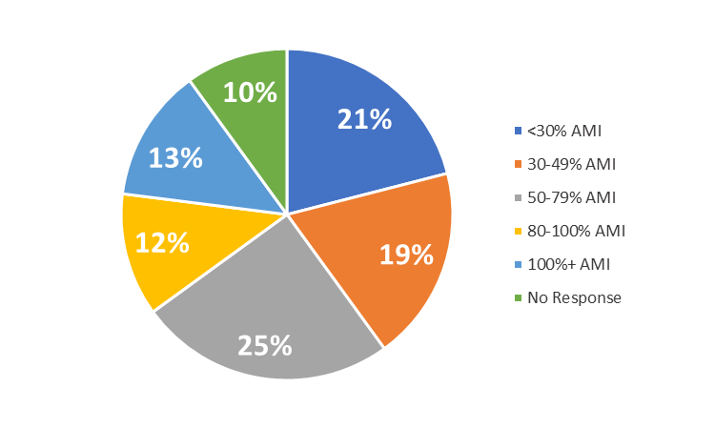
Service Usage: Income Demographics (FY 17)

Slide 16
Using Research and Metrics to Inform Program Decisions
Research and data allow us to
Understand who uses these resources and for what purpose
Evaluate unmet needs and service gaps
Demonstrate the impact of the program
Assess the benefits to clients from the program
Overall, metrics and research enable more effective program management and service delivery

Slide 17
Using Research and Metrics to Inform Program Decisions
Example: Research shows initiation and completion rates for housing counseling services vary based on delivery mechanism
Training added to encourage agencies to use a wider variety of methods to deliver counseling
Example: Currently the demand and funding for services is shifting from foreclosure prevention to pre-purchase counseling
Training may be required to ensure appropriate resources are available to meet this need

Slide 18
Using Research and Metrics to Inform Program Decisions
Example: Research suggests that there is a lack of awareness of the availability of counseling
Selection bias research problem can be a program opportunity
HUD has prioritized raising awareness and visibility efforts so that those who would benefit from program are aware of it

Slide 19
Using Research and Metrics for Policy and Scale
HUD data elements mapped and adopted to meet mortgage industry standards (MISMO)
Lending industry can now track housing counseling data
HUD shares data and research with industry to encourage policies to support housing counseling in lending, renting, foreclosure prevention, and disaster recovery

Slide 20
For More Information About Housing Counseling
www.hudexchange.info/programs/housing-counseling
Send questions to housing.counseling@hud.gov
Or contact:
Dr. Marina L. Myhre, Office of Policy Development & Research
Marina.L.Myhre@hud.gov or 202-402-5705
Sarah S. Gerecke, Office of Housing Counseling
Sarah.S.Gerecke@hud.gov or 202-402-3453

