Slide 1
EIA Emergency Response
For
Committee on National Statistics
October 19, 2018 | Washington, D.C.
By
Linda Capuano, Administrator

Slide 2
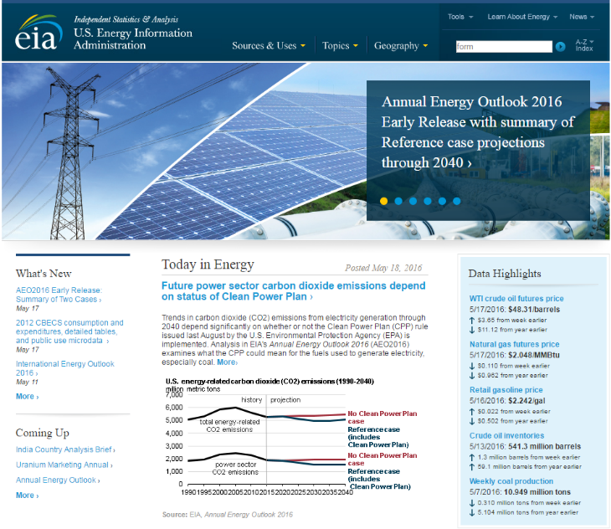
The Nation’s source of energy information
EIA collects, analyzes, and disseminates independent and impartial energy information to promote sound policymaking, efficient markets, and public understanding of energy and its interaction with the economy and the environment.
EIA’s products are independent
By law, EIA’s data, analyses, and forecasts are independent of approval by any other officer or employee of the United States Government.

Slide 3
Solid legal foundation and trust
Legal right to collect
Federal Energy Administration Act of 1974 (Public Law 93‐275)
Department of Energy (DOE) Organization Act of 1977 (Public Law 95-91)
Other legal mandates
Legal obligation to protect
Confidential Information Protection and Statistical Efficiency Act (CIPSEA), Title V of the E-Government Act of 2002 (Pubic Law 107-347)
Freedom of Information Act, 5 USC. 552, exemptions 3, 4, and 6
Paperwork Reduction Act, 44 U.S.C. 3501
Information Quality Act, P.L. No. 106-554; H.R. 5658, Section 515(a)

Slide 4
EIA is a Principal Federal Statistical Agency
Three Branches of Government: Executive; Legislative; and Judiciary.
Executive Branch – 15 Departments
190 Agencies within 15 Departments
90 out of 190 Agencies perform various statistical collections
13 out of 90 are Principal Federal Statistical Agencies

Slide 5
EIA’s data collection and analytical products integrate all energy sectors

Slide 6
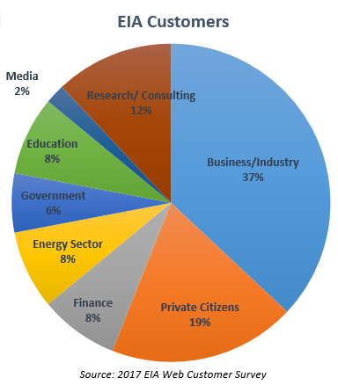
EIA stakeholders
Business/Industry
Manufacturers – market research
Energy Sector
Consumers – monitor price forecasts
Producers – track inventory statistics
Finance/Consulting
Commodities Analysts – market response to supply data
Private Citizens
Public – research gasoline prices
Government
Executive Agencies – WH, DOE, & EPA use EIA data to track energy markets and program performance and to analyze policy proposals
Congress – policy development and agency funding
State Governments – planning and program development
Media/Education
Journalists – cite energy statistics
Teachers – use Energy Kids materials
Researchers – energy forecasting and modeling
Linda Capuano, Committee on National Statistics October 19, 2018

Slide 7
EIA Data Products and Tools
EIA Analytical Products
Coal Data Browser
Crude Import Tool
Weekly Natural Gas Storage Report
Weekly Petroleum Status Report
Hourly Electric Load Tool
Residential Energy Consumption
Annual Energy Outlook
International Energy Outlook
Short-Term Energy Outlook
This Week in Petroleum
Natural Gas Weekly Update
Today in Energy

Slide 8
EIA publishes many data series that can be helpful during energy disruptions
Weekly gasoline and diesel retail prices
Weekly crude oil and petroleum product inventories
Weekly natural gas inventories
Daily spot prices
Hourly electricity load by balancing authority
Source: U.S. Energy Information Administration

Slide 9
EIA works closely with DOE and other agencies during energy disruptions
DOE’s Office of Cybersecurity, Energy Security, and Emergency Response (CESER)
CESER leads DOE’s emergency preparedness and coordinated response to energy sector disruptions, including physical and cyber-attacks, natural disasters, and man-made events.
Infrastructure Security and Energy Restoration Division (ISER) leads efforts to secure U.S. energy infrastructure against hazards, reduce disruptive event impact, and respond to and facilitate recovery, in collaboration with industry and state and local governments.
The Cybersecurity for Energy Delivery Systems Division mitigates the risk of energy disruption from cyber incidents and other emerging threats within the energy environment.
EIA is independent but coordinates with CESER and others during emergency events
EIA publishes independent Energy Disruption pages data and analysis and provides data and to CESER

Slide 10
EIA works closely DOE and other agencies during energy disruptions
Supports situational awareness by participating and coordinating with
Department of Energy, Office of Cybersecurity, Energy Security, and Emergency Response (CESER)
Federal Emergency Management Agency (FEMA)
Department of Transportation, Pipeline and Hazardous Materials Safety Administration (PHMSA)
State Energy Offices
Canadian National Energy Board (NEB)
Others
Independently publishes information on its EIA.gov Disruption Pages

Slide 11
EIA’s energy disruptions page features interactive map layers displaying energy infrastructure and weather information
Eia.gov/special/disruptions interactive map layers include:
Refineries, terminals, crude oil and petroleum product pipelines
Oil and gas wells and offshore platforms
Natural gas processing plants and pipelines
Power plants
Coal mines
Weather indicators from NOAA
Source: U.S. Energy Information Administration

Slide 12
EIA releases daily electricity status reports during hurricanes
Eia.gov/special/disruptions/archive/hurricane/Michael reports features:
Hourly electricity load for balancing authorities in the affected areas
Weather data including precipitation, wave height, and wind speed
Maps featuring the projected storm path and the location of nuclear power plants
Estimates of customers by state for each balancing authority
Source: U.S. Energy Information Administration

Slide 13
EIA posts custom dashboards to monitor select markets such as Southern California natural gas
Eia.gov/special/disruptions/socal reports feature:
Daily natural gas receipts and sendout
Daily net inventory change
Hourly electricity load
Natural gas and electricity prices
Map featuring natural gas infrastructure
Source: U.S. Energy Information Administration

Slide 14
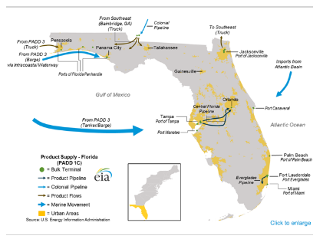
EIA posts analysis products covering emerging trends in energy markets
Today in Energy
This Week in Petroleum
Source: U.S. Energy Information Administration

Slide 15
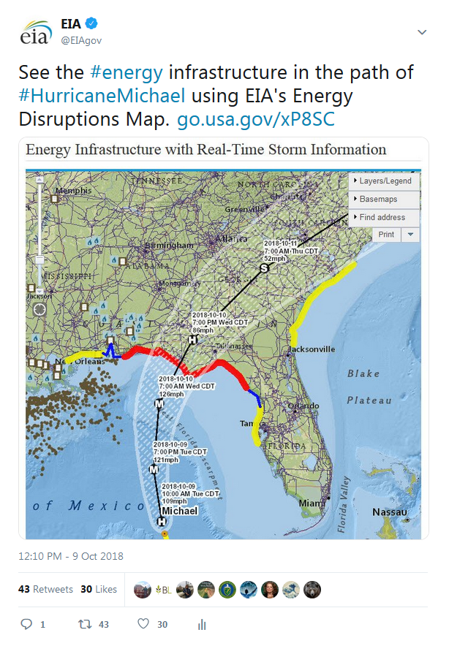
EIA leverages social media to disseminate energy data
EIA tweets and posts links
on-demand energy analysis
near real-time electricity data
daily status reports
online tools that provide on-demand access to more frequent energy information updates
Access available to all
Federal and state agencies, regional and local
First responders to emergency operations centers
Direct to mobile phones
Source: U.S. Energy Information Administration

Slide 16
For more information
Linda Capuano, Administrator
linda.capuano@eia.gov, 202-586-6351
Stephen Nalley, Deputy Administrator
stephen.nalley@eia.gov, 202-586-6351
Subject matter experts for this presentation:
Hannah Breul, Team Lead, Petroleum Markets Analysis
hannah.breul@eia.gov, 202-586-4522
Dale Sweetnam, Communications Manager, Content Operations Team
dale.sweetnam@eia.gov, 202-586-0851
Dennis Mesina, Public Affairs Specialist
dennis.mesina@eia.gov, 202-586-1377

